Slide 1
Arta 309: Homework 2
Art analysis of Velazquez ‘painting
Las Meniñas.
Due on November 12, 2020

Slide 2

Diego Velazquez. Las Meninas. (The Maids of Honor).1656.
(3 m 18 x 2 m 75) - 10 ½ x 9 ¾
Look carefully at this artwork and using the handout :
The viewer / reception of the artwork:
1/ identify the artwork.
2/ Describe the subject matter.
What is the story depicted? What do you see?
3/ Make a brief formal analysis.
How is the composition?
Is there focal point (s)?
How is the use of light?
Is there use of perspective? If yes , how do you see that?
Is there any details that make this painting intriguing and unique?

Slide 3
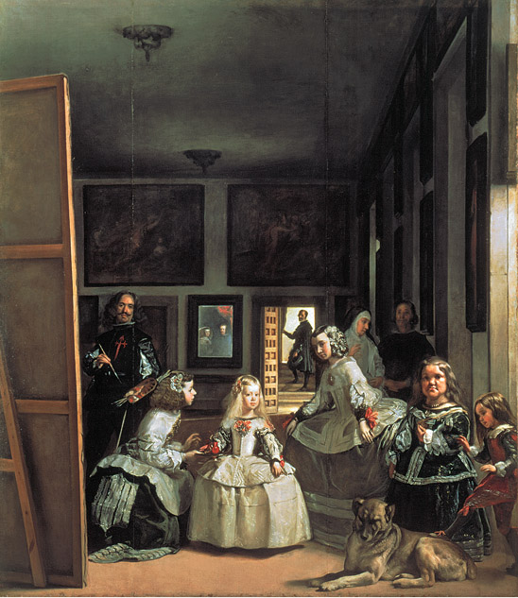
Velazquez. El cuadro de la Familia. 1656. known as Las Meninas ( the Maids of Honor)
Notes:
Artist: Diego Velázquez
Title: Las Meninas (The Maids of Honor)
Medium: Oil on canvas
Size: 10'5" X 9'½" (3.18 X 2.76 m)
Date: 1656
Source/ Museum: Museo del Prado, Madrid

Slide 4
Correction
Artist: Diego Velazquez :1500-1660
Title: Las Meninas – The Maids of Honor
Medium: Oil on canvas
Painting size: 9 ¾ x 10 ½ feet
Date: 1656 repainted in 1658
Style: Baroque period
Patron: Commissioned by and painted for King Phillip IV of Spain
Function: Portrait of Infanta Margarita and Royal family.
: Artist Diego Velázquez self portrait among
members of King’s court.

Slide 5
Notes:
Artist: Diego Velázquez
Title: Las Meninas (The Maids of Honor)
Medium: Oil on canvas
Size: 10'5" X 9'½" (3.18 X 2.76 m)
Date: 1656
Source/ Museum: Museo del Prado, Madrid

